Slide 1

Python 101

Slide 2
Plan
Install Python
Datatypes
Loops, Conditions, Functions
Manage Packages
Development environments: Jupyter & VS Code
File system
Advanced dev stuffs: Virtual environments, Unit testing, …

Slide 3

xkcd.com/353/
Notes:
https://xkcd.com/353/

Slide 4
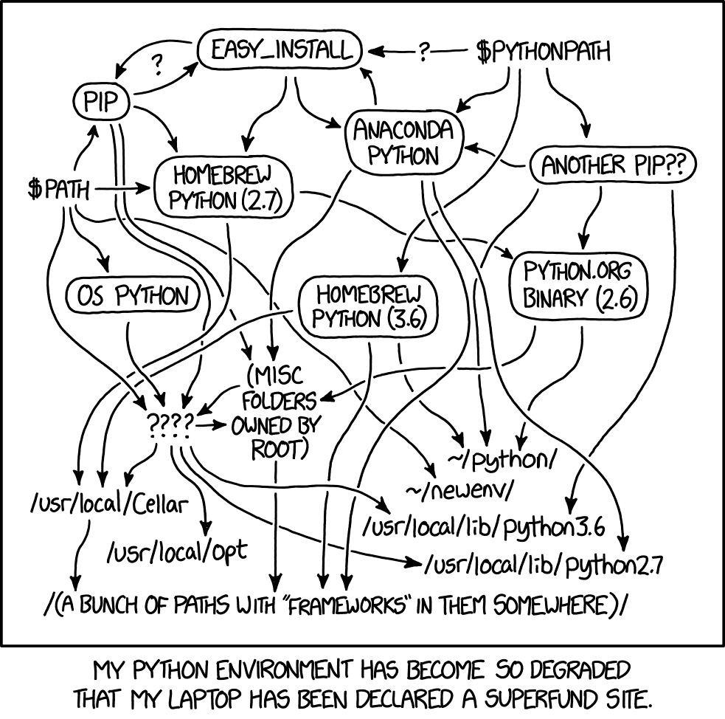
Python distributions
Base Python on Python.org
Anaconda
WinPython
Intel Distribution for Python
Compile from Source
Enthought Python
xkcd.com/1987/

Slide 5

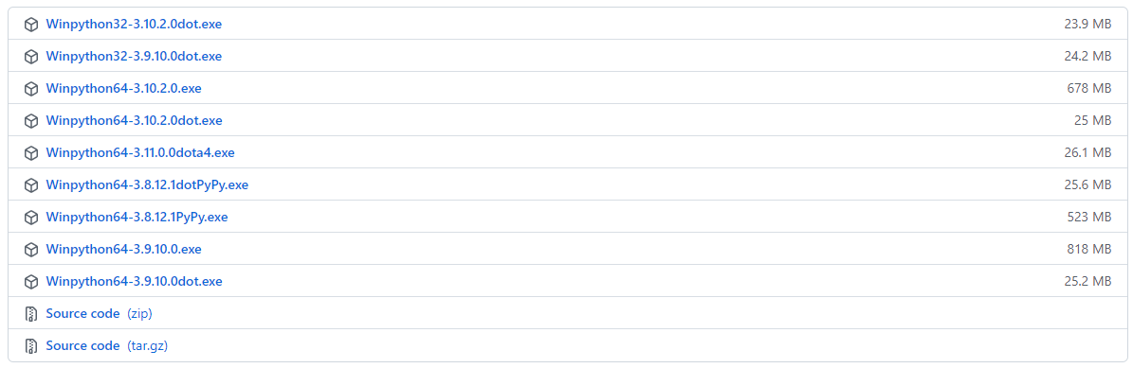
Winpython64-3.9.10.0
WinPython64-3.9.10.0 = Python 3.9.10 64bit + PyQt5 + Spyder + Pytorch : Changelog, Packages
Source: WinPython - Release of January 25th, 2022
Notes:
https://winpython.github.io/

Slide 6
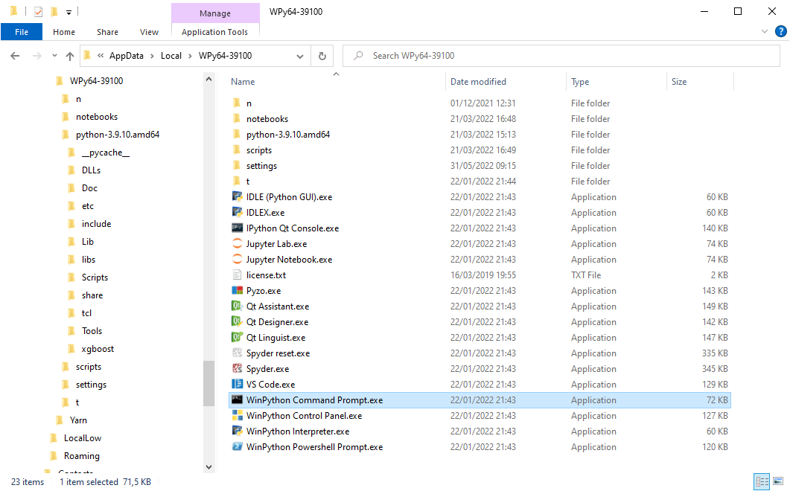
What you get

Slide 7
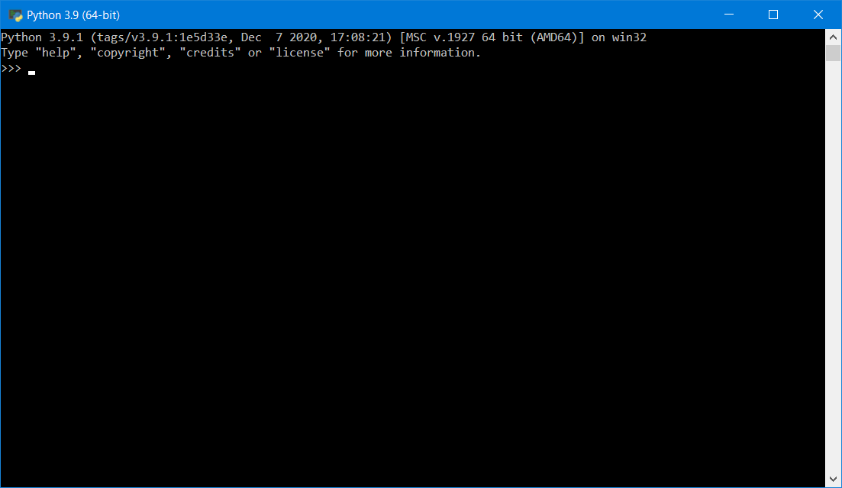
First steps with the prompt

Slide 8
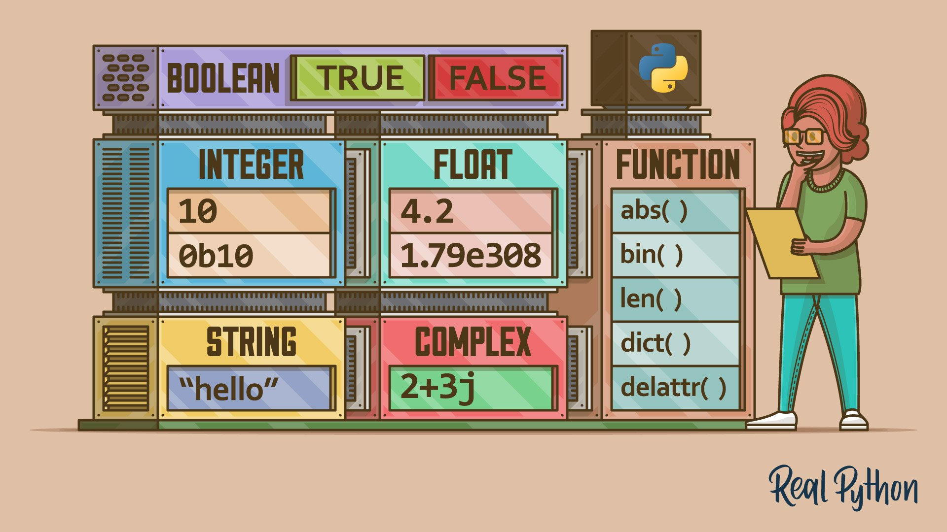
https://realpython.com/python-data-types/
Notes:
https://realpython.com/python-data-types/
https://realpython.com/python-data-structures/

Slide 9
1. Datatypes
Integer
Float
String
List
Dict
More advanced datatypes:
Array
Dataframe
…

Slide 10
Numerics & strings
>>> x = 42 # no semicolon required
>>> type(x)
>>> pi = 3.14
>>> type(pi)
>>> "hello" + x
>>> "hello" + str(x)
Notes:
Python 3: 3/2 = 1.5
Python 2: 3/2 = 1
/!\ Pass by ref (not by value):
>>> a = [1,2]
>>> b = [1,a]
>>> b
[1, [1, 2]]
>>> a[1] = 3
>>> a
[1, 3]
>>> b
[1, [1, 3]]

Slide 11
More on Strings
6.1: A string is a sequence
6.2: Getting the length of a string using len
6.3: Traversal through a string with a loop
6.4: String Slices
6.5: Strings are immutable
6.6: Looping and Counting
6.7: The in operator
6.8: String Comparison
6.9: String Methods
6.E: Strings (Exercises)
6.G: Strings (Glossary)
6.10: Parsing strings
6.11: Format operator
6.12: Debugging
Python for Everybody – Chap 6 Strings
PY4E – HTML

Slide 12

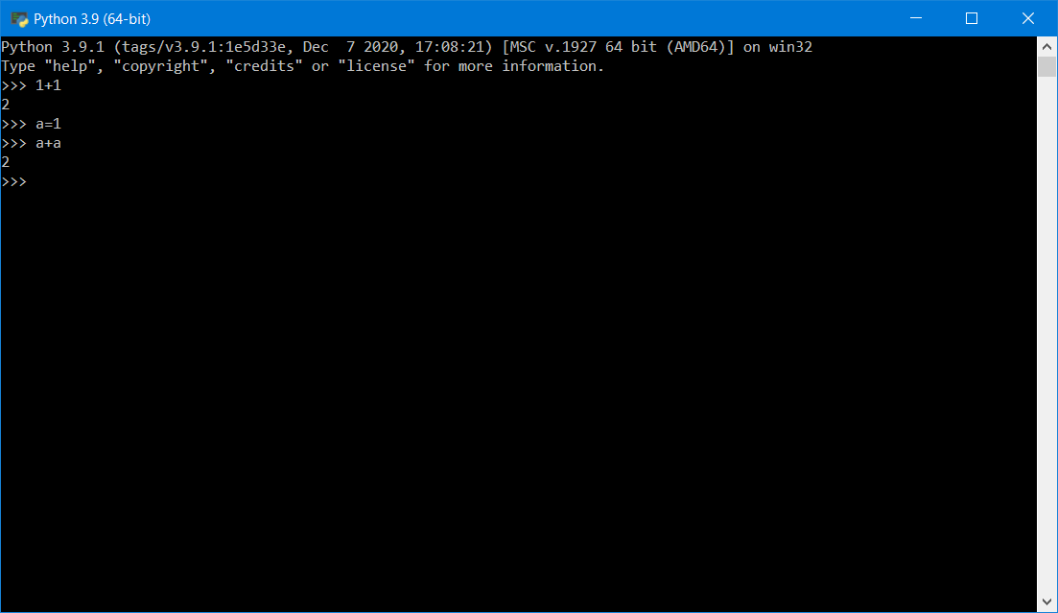
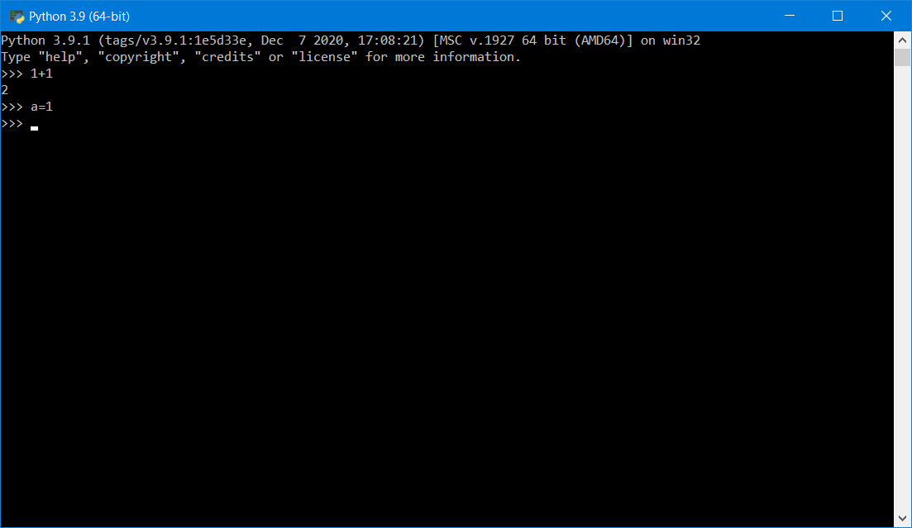
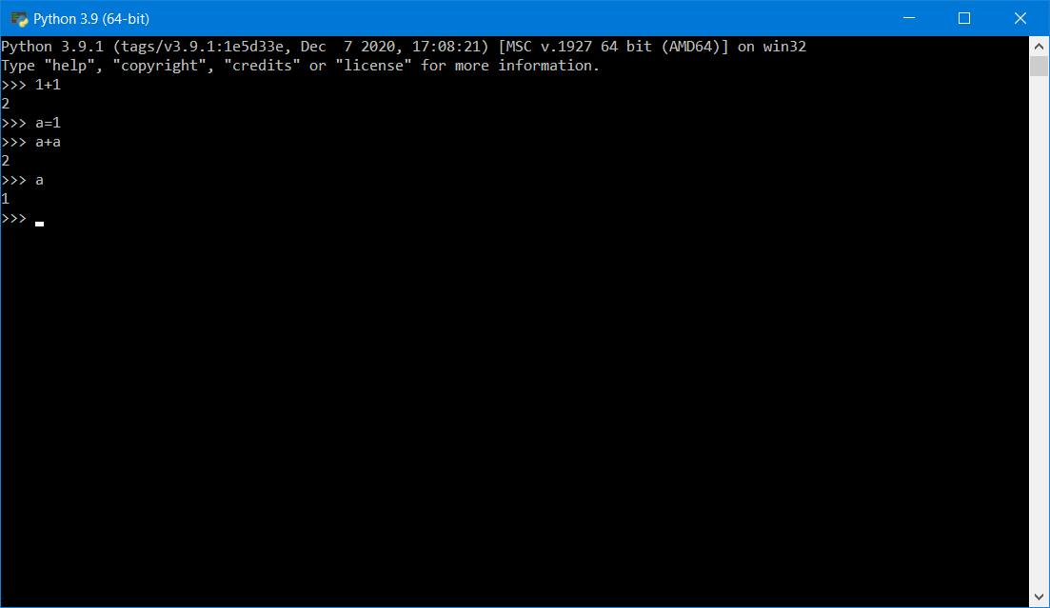
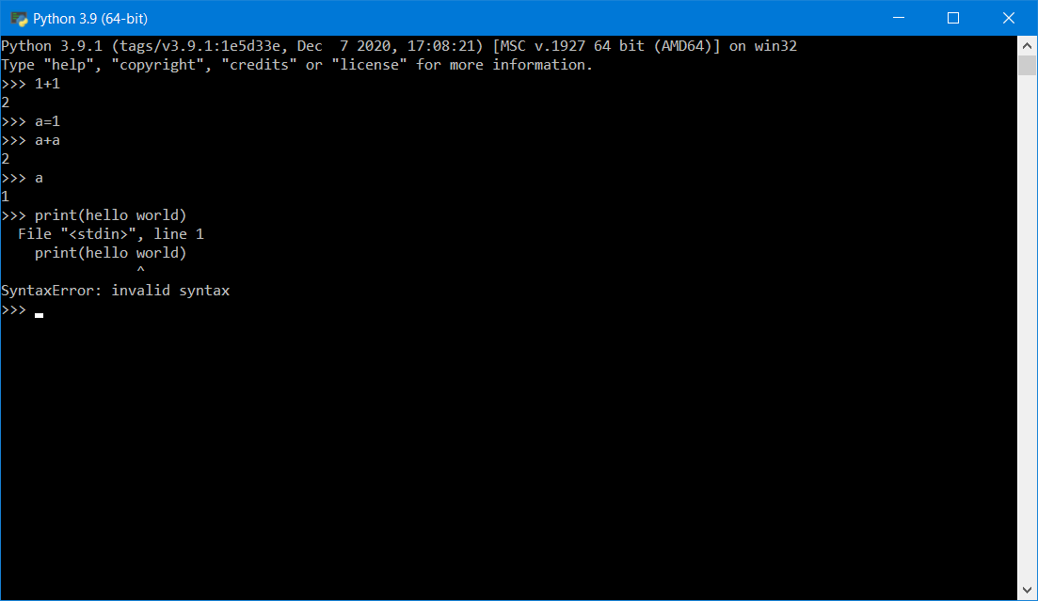
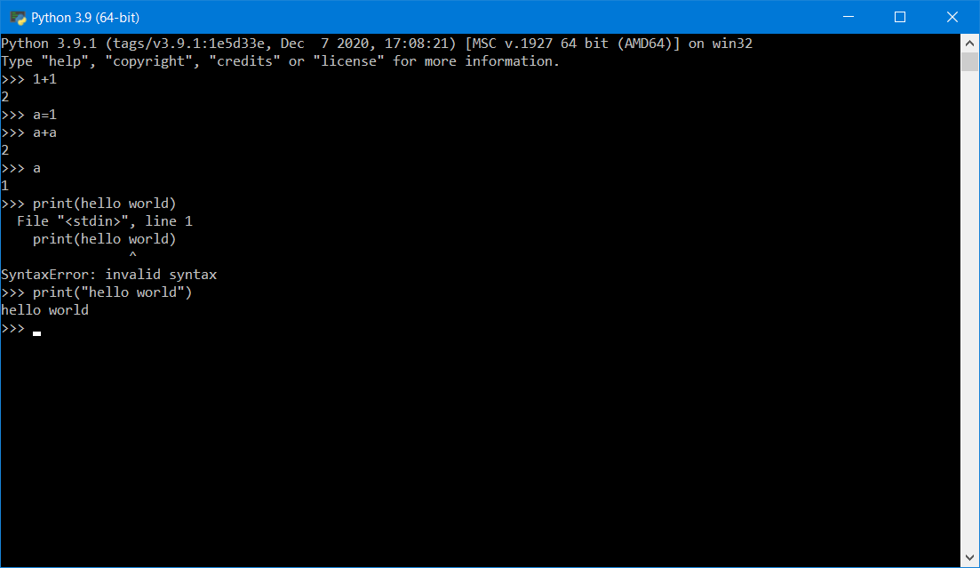
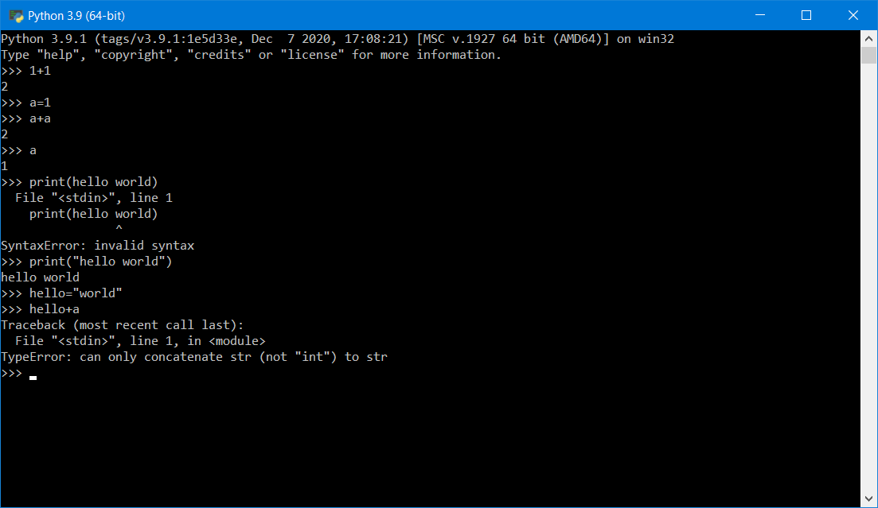
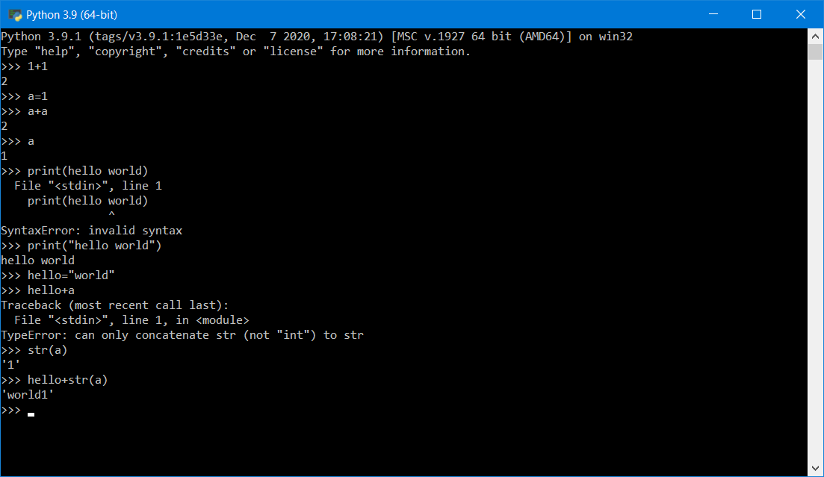

Slide 13
Lists & Dictionaries
>>> t = [1,2,3]
>>> t[1]
>>> t[0]
>>> d = {'temp': 32, 'pressure': 1013}
>>> d[1]
>>> d['temp']
More on lists
More on dictionaries
Notes:
docs.python.org/3/tutorial/datastructures.html#more-on-lists
docs.python.org/3/tutorial/datastructures.html#dictionaries
Dictionaries: so fundamental to the Python ecosystem that they are introduced in the first lesson or two.
MATLAB will be releasing a dictionary type in 2022b

Slide 14
More on Lists
8.1: A list is a sequence
8.2: Lists are mutable
8.3: Traversing a List
8.4: List operations
8.5: List Slices
8.6: List Methods
8.7: Deleting Elements
8.8: Lists and Functions
8.9: Lists and Strings
8.E: Lists (Exercises)
8.G: Lists (Glossary)
8.10: Parsing lines
8.11: Objects and Values
8.12: Aliasing
8.13: List arguments
8.14: Debugging
PY4E - HTML
Python for Everybody - Chap 8 Lists

Slide 15
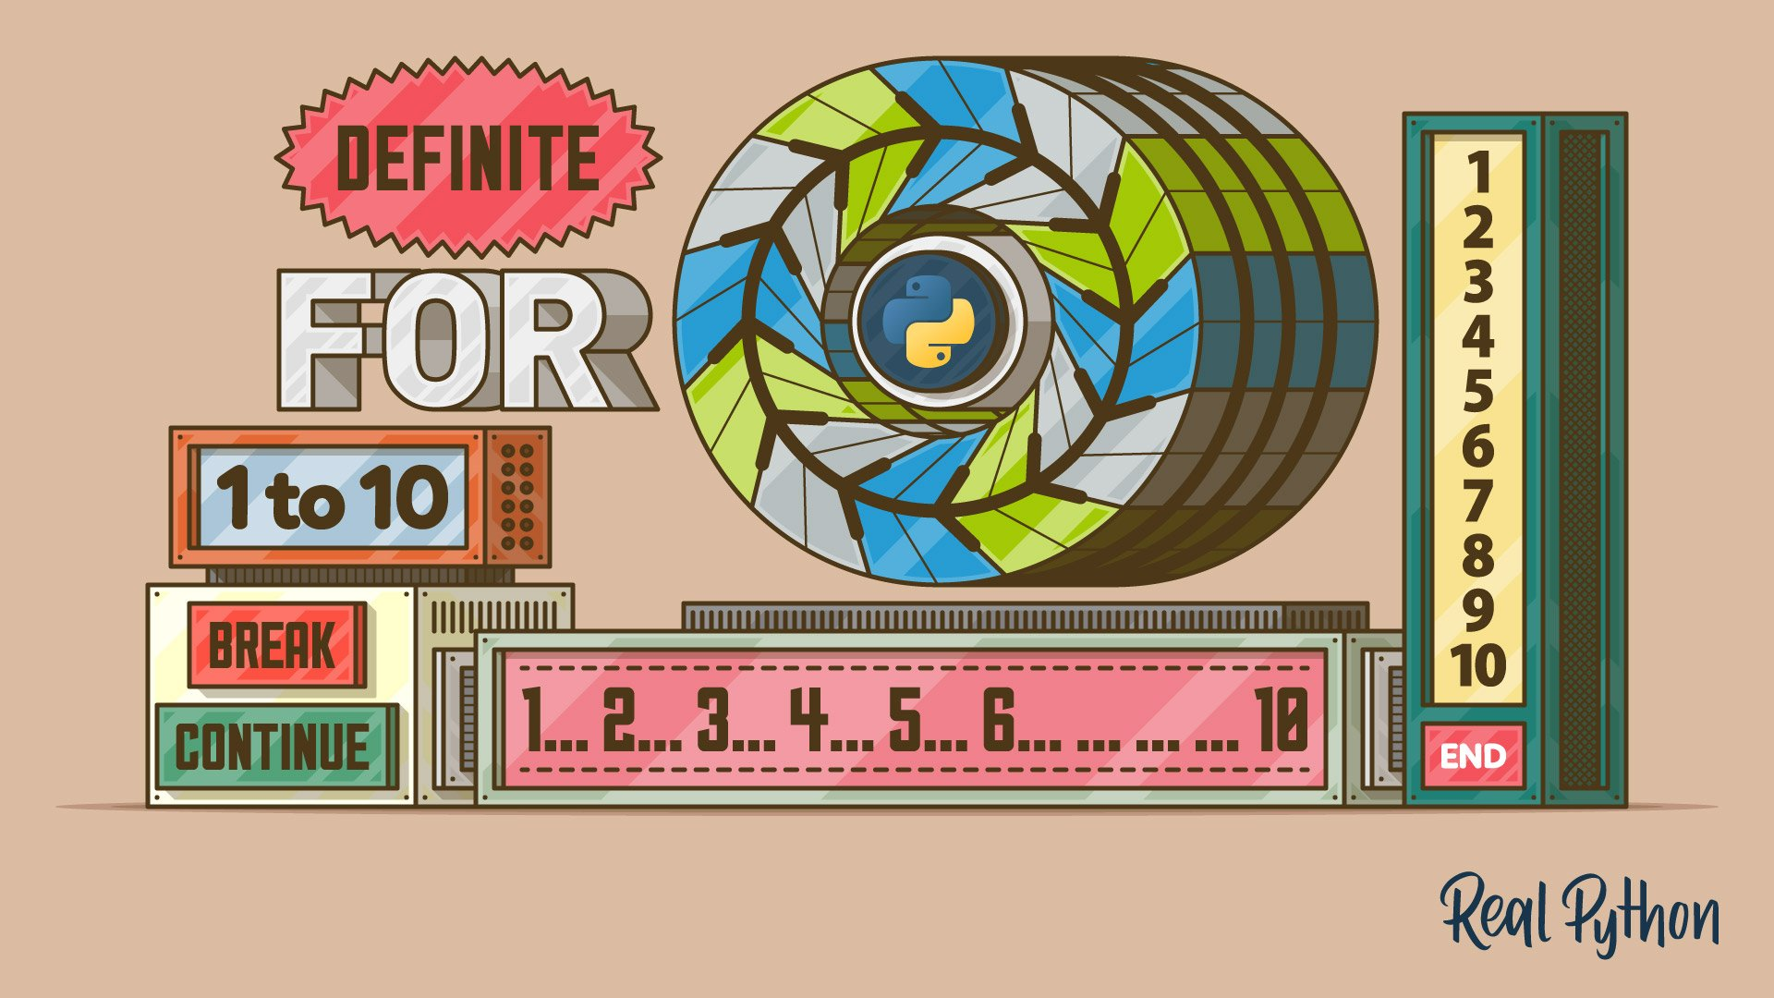

https://realpython.com/python-for-loop/
Notes:
https://realpython.com/python-for-loop/

Slide 16
2. Loops , Conditions, Functions
Loops
Conditions
Functions
Write your first program (in Notepad)

Slide 17
Loops
Code along
>>> for i in t:
... print(i)
>>> words = ['banana', 'oranges', 'apples']
>>> for w in words:
... print(w, len(w))
...
banana 6
oranges 7
apples 6
Notes:
docs.python.org/3/tutorial/controlflow.html#for-statements
docs.python.org/3/tutorial/datastructures.html#list-comprehensions
https://realpython.com/python-for-loop/
https://realpython.com/python-range/
Add list comprehension

Slide 18
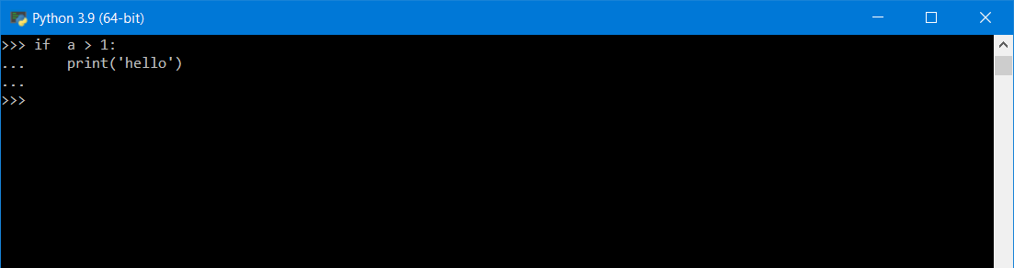
Conditions
>>> if i > 2:
... print(i)
Notes:
docs.python.org/3/tutorial/datastructures.html#more-on-conditions

Slide 19
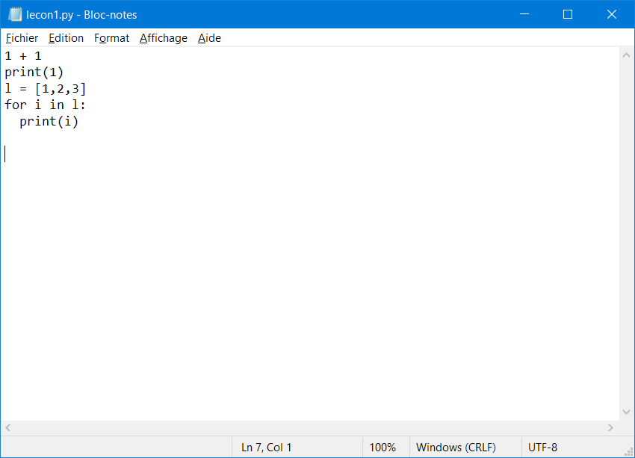

Slide 20
Scripts
test.py
l = [1,2,3]
for i in l:
print(i)
$ python test.py
1
2
3

Slide 21
Functions
test2.py
l = [1,2,3]
def bigger(l):
for i in l:
if i>2:
print(i)
bigger(l)
$ python test2.py
2

Slide 22
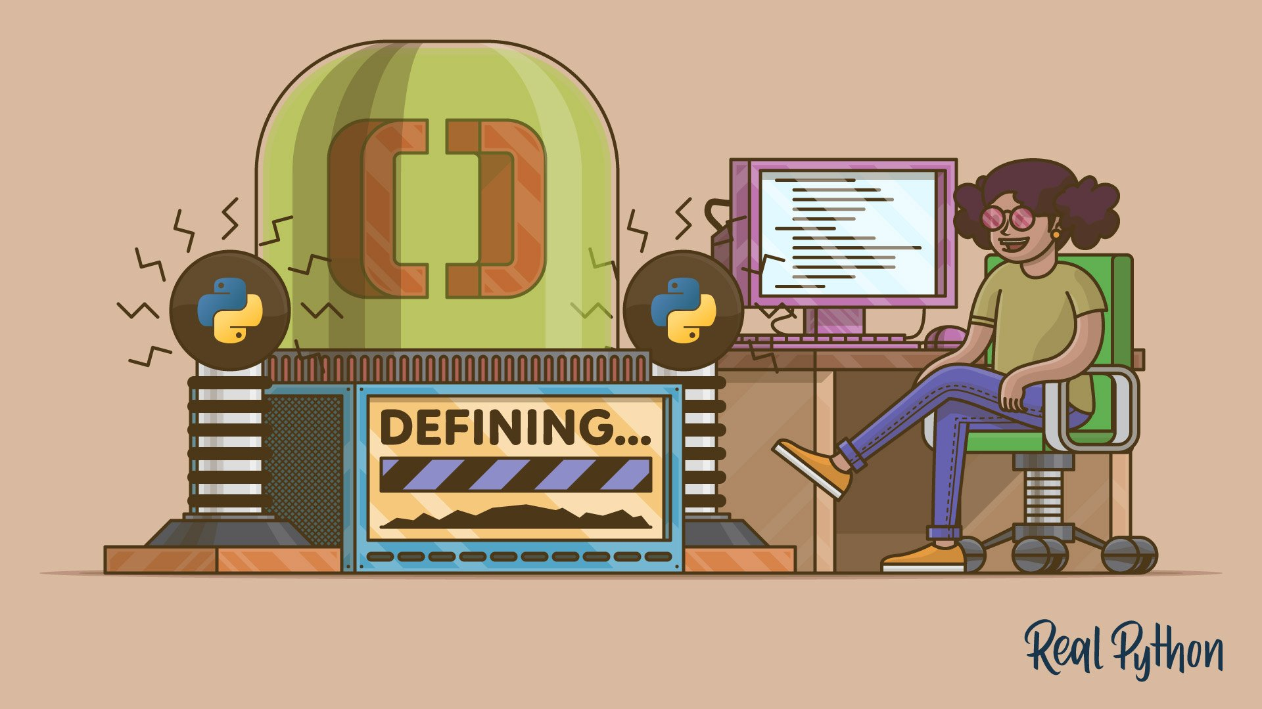
https://realpython.com/defining-your-own-python-function/

Slide 23
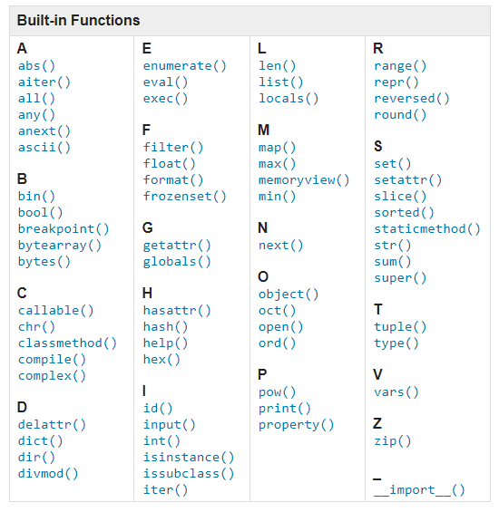
Built-in Functions
Built-in Functions
A abs() aiter() all() any() anext() ascii() B bin() bool() breakpoint() bytearray() bytes() C callable() chr() classmethod() compile() complex() D delattr() dict() dir() divmod() | E enumerate() eval() exec() F filter() float() format() frozenset() G getattr() globals() H hasattr() hash() help() hex() I id() input() int() isinstance() issubclass() iter() | L len() list() locals() M map() max() memoryview() min() N next() O object() oct() open() ord() P pow() print() property() | R range() repr() reversed() round() S set() setattr() slice() sorted() staticmethod() str() sum() super() T tuple() type() V vars() Z zip() _ __import__()
Built-in Functions — Python documentation

Slide 24

https://realpython.com/python-modules-packages/

Slide 25

Standard Modules
>>> import this
>>> import math
>>> math.sqrt(4)
2
>>> from math import sqrt
>>> sqrt(4)
2
Walking Randomly » Python rant: ‘ from foo import * ‘ is bad
Notes:
docs.python.org/3/reference/import.html
docs.python.org/3/tutorial/modules.html
docs.python.org/3/library/math.html
/!\ `from math import *` is very bad and should be punished by death
https://walkingrandomly.com/?p=6209
Python doesn’t just have one version of a function….there are many. E.g. look at all the different behaviours of sqrt!
Good: Namespaces are good. MATLAB doesn’t have them. This is bad
Bad: You are a user and you want to do foo. Which foo do you use? Even the official toolchain has many variants. Fun times!

Slide 26
Standard Modules (2) Exercise
Import the urlopen function from the urllib.request submodule
>>> import urllib.request
>>> url = "https://samples.openweathermap.org/"
>>> res = urllib.request.urlopen(url)
>>> res.read()
Notes:
docs.python.org/3/tutorial/modules.html
docs.python.org/3/library/math.html
docs.python.org/3/library/urllib.request.html
docs.python.org/3/library/urllib.request.html#urllib.request.urlopen
Proceed further with:
https://samples.openweathermap.org/data/2.5/weather?q=London&appid=b6907d289e10d714a6e88b30761fae22

Slide 27
User-defined Modules
my_mod.py
def my_fun(l):
for i in l:
if i%2 == 0:
print(i)
>>> import my_mod
>>> l = [1,2,3]
>>> my_mod.my_fun(l)
>>> from my_mod import my_fun
>>> l = [1,2,3]
>>> my_fun(l)
Notes:
Interaction/Question to the audience: How would you do that in MATLAB? By default in MATLAB one function per file
AND
Equivalent of +my_mod in MATLAB

Slide 28
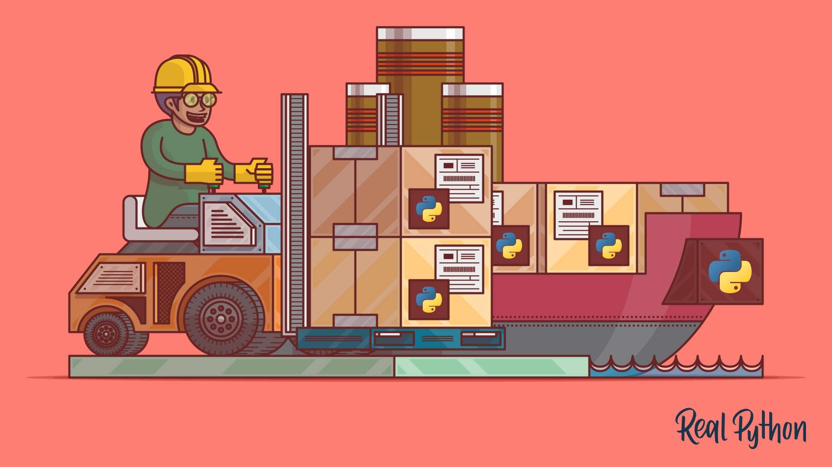

More on import and namespaces
https://realpython.com/python-import/
https://realpython.com/python-namespaces-scope/

Slide 29

https://realpython.com/what-is-pip/

Slide 30


Development environments

Slide 31

https://realpython.com/jupyter-notebook-introduction/
Notes:
Critical element that made Python

Slide 32



Jupyter
Notebook Format
Interactive Computing Protocol
Kernel
Notes:
Jupyter Notebooks have become over the years, one of the most used and appreciated data science tools. They combine text (as Markdown), code, and output (numerical and graphical). Notebooks help data scientist to communicate goals, methods and results. It can be seen as an executable form of textbook or scientific paper.
Jupyter stands for Julia, Python and R, but it is also an homage to Galileo’s notebooks recording the discovery of the moons of Jupiter.
Jupyter is a project that spun off in 2014 from IPython. IPython stands for Interactive Python and was created in 2001 by Fernando Perez. He drew his inspiration from Maple and Mathematica that both had notebook environments. He really liked the Python language, but he felt limited by the interactive prompt to do scientific computing. So he wrote a python startup file to provide the ability to hold state and capture previous results for reuse, and adding some nice features like loading the Numeric library and Gnuplot. 'ipython-0.0.1' was born, a mere 259 lines to be loaded as $PYTHONSTARTUP.
Around 2006, the IPython project took some inspiration from another open-source project called Sage. The Sage Notebook was taking the route of using the filesystem for notebook operations. You couldn’t meaningfully list files with ls or move around the filesystem by changing directory with cd. Sage would execute your code in hidden directories with each cell actually being a separate subdirectory.
In 2010, the architecture of IPython evolved by separating the notebook front-end from the kernel executing Python code, and communicating between the two with the ZeroMQ protocol. This design enabled the development of a Qt client, a Visual Studio extension, and finally a web frontend.

Slide 33
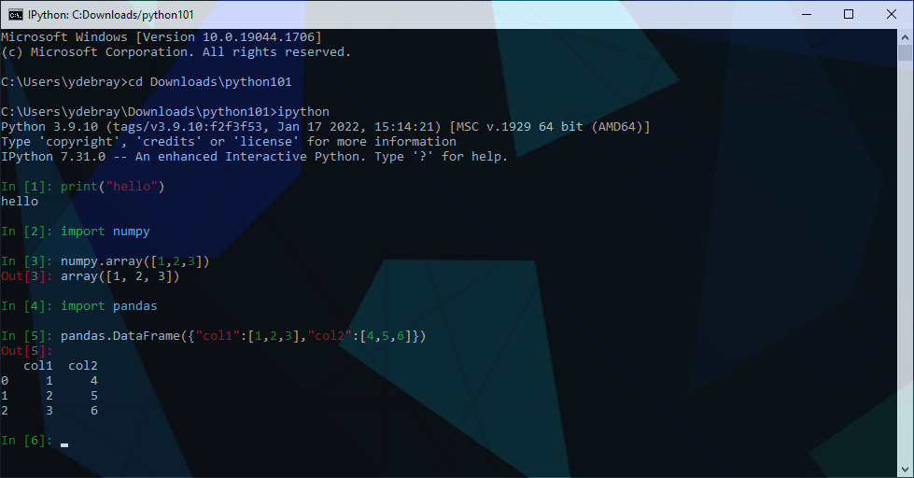
Before Jupyter IPython

Slide 34
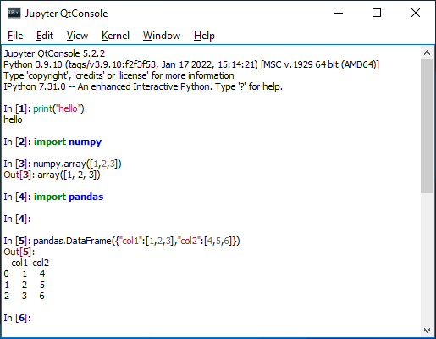
Before Jupyter Ipython Qt Console

Slide 35
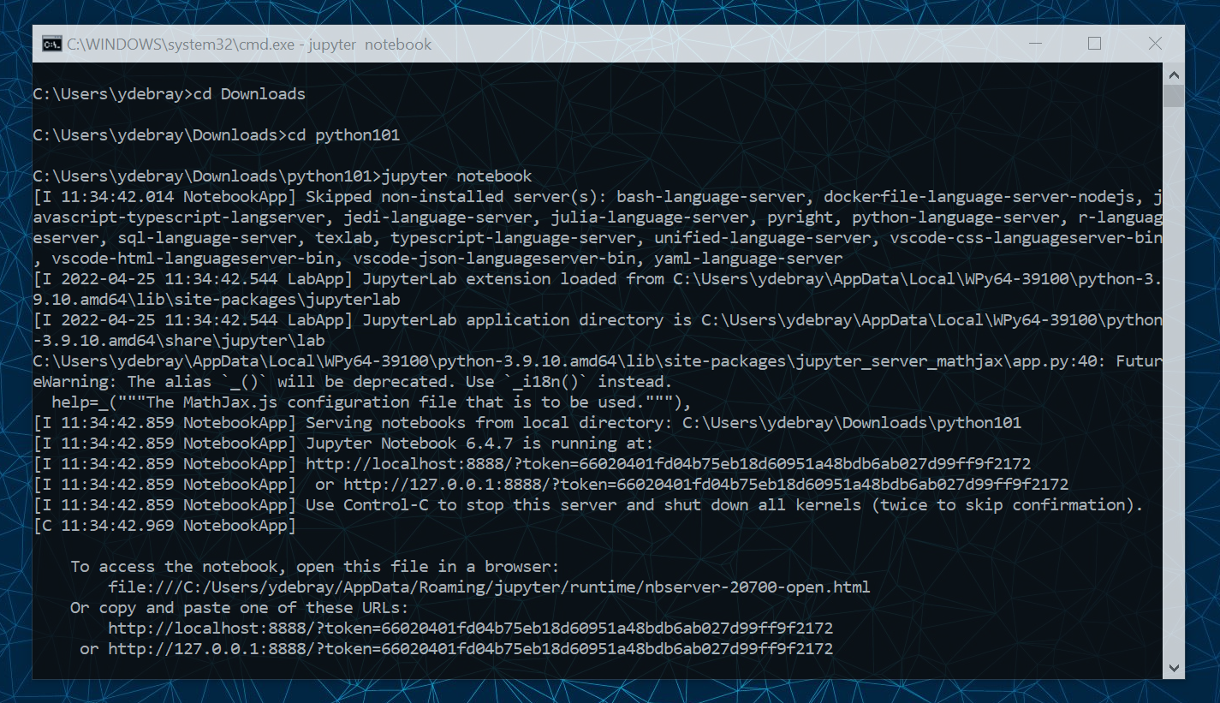

Slide 36
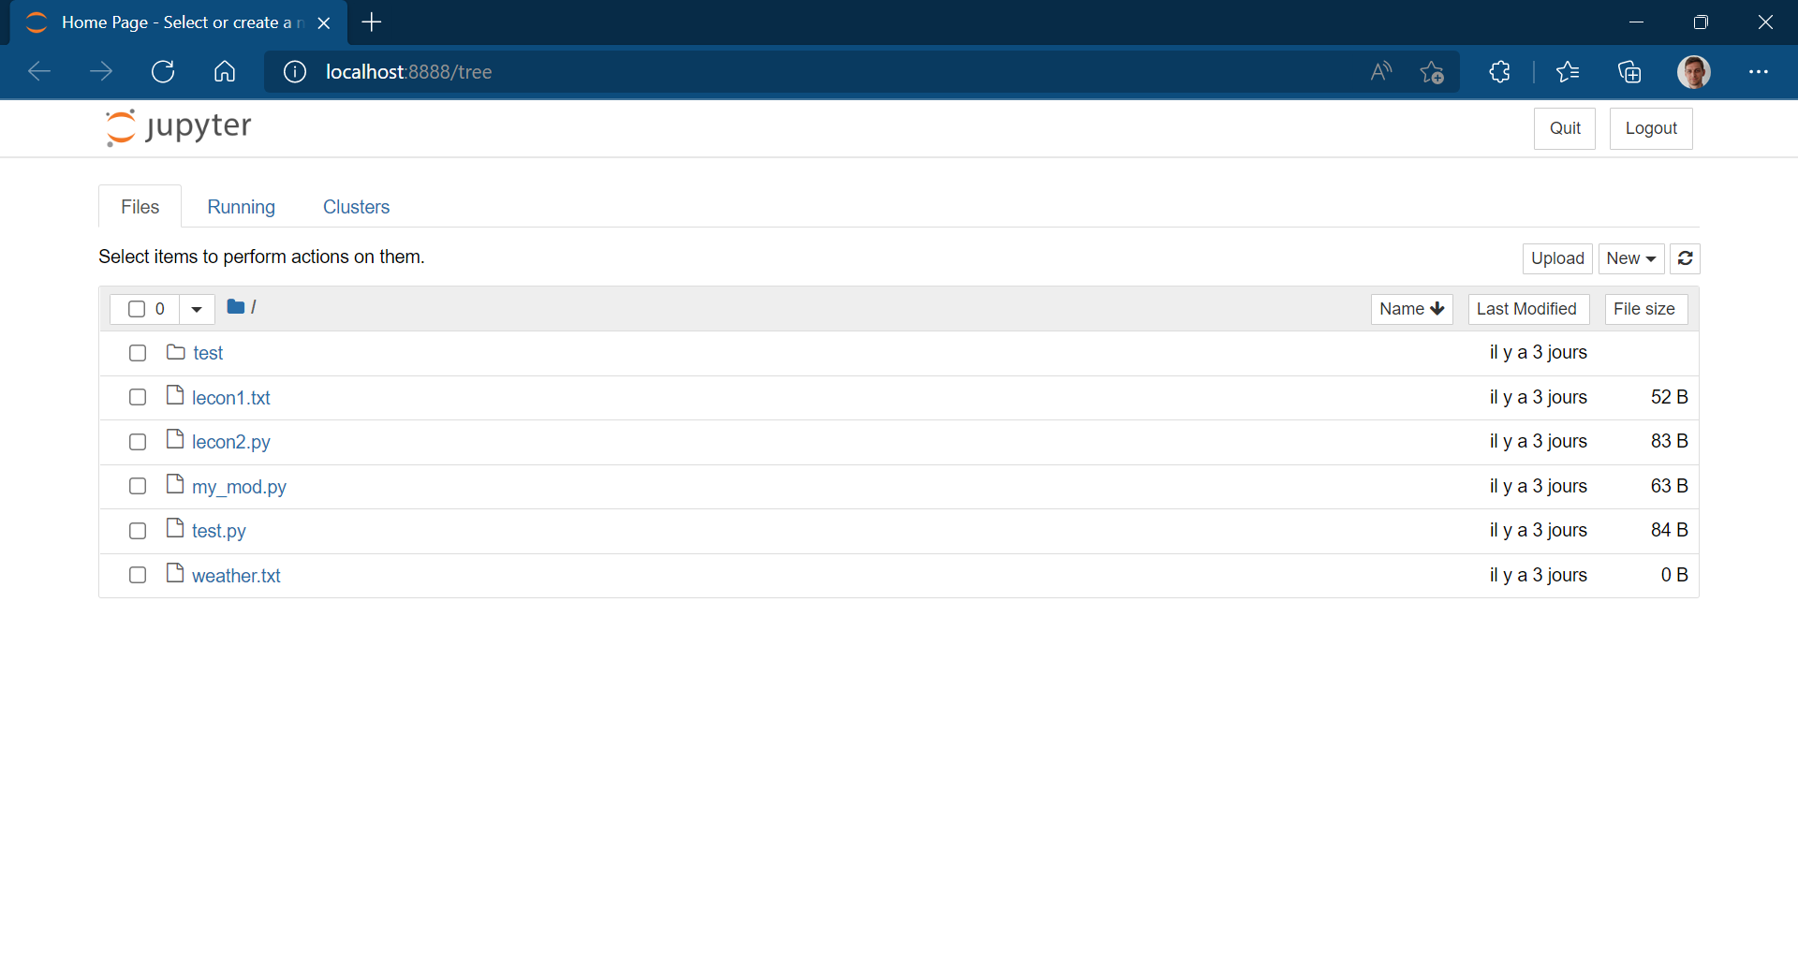

Slide 37
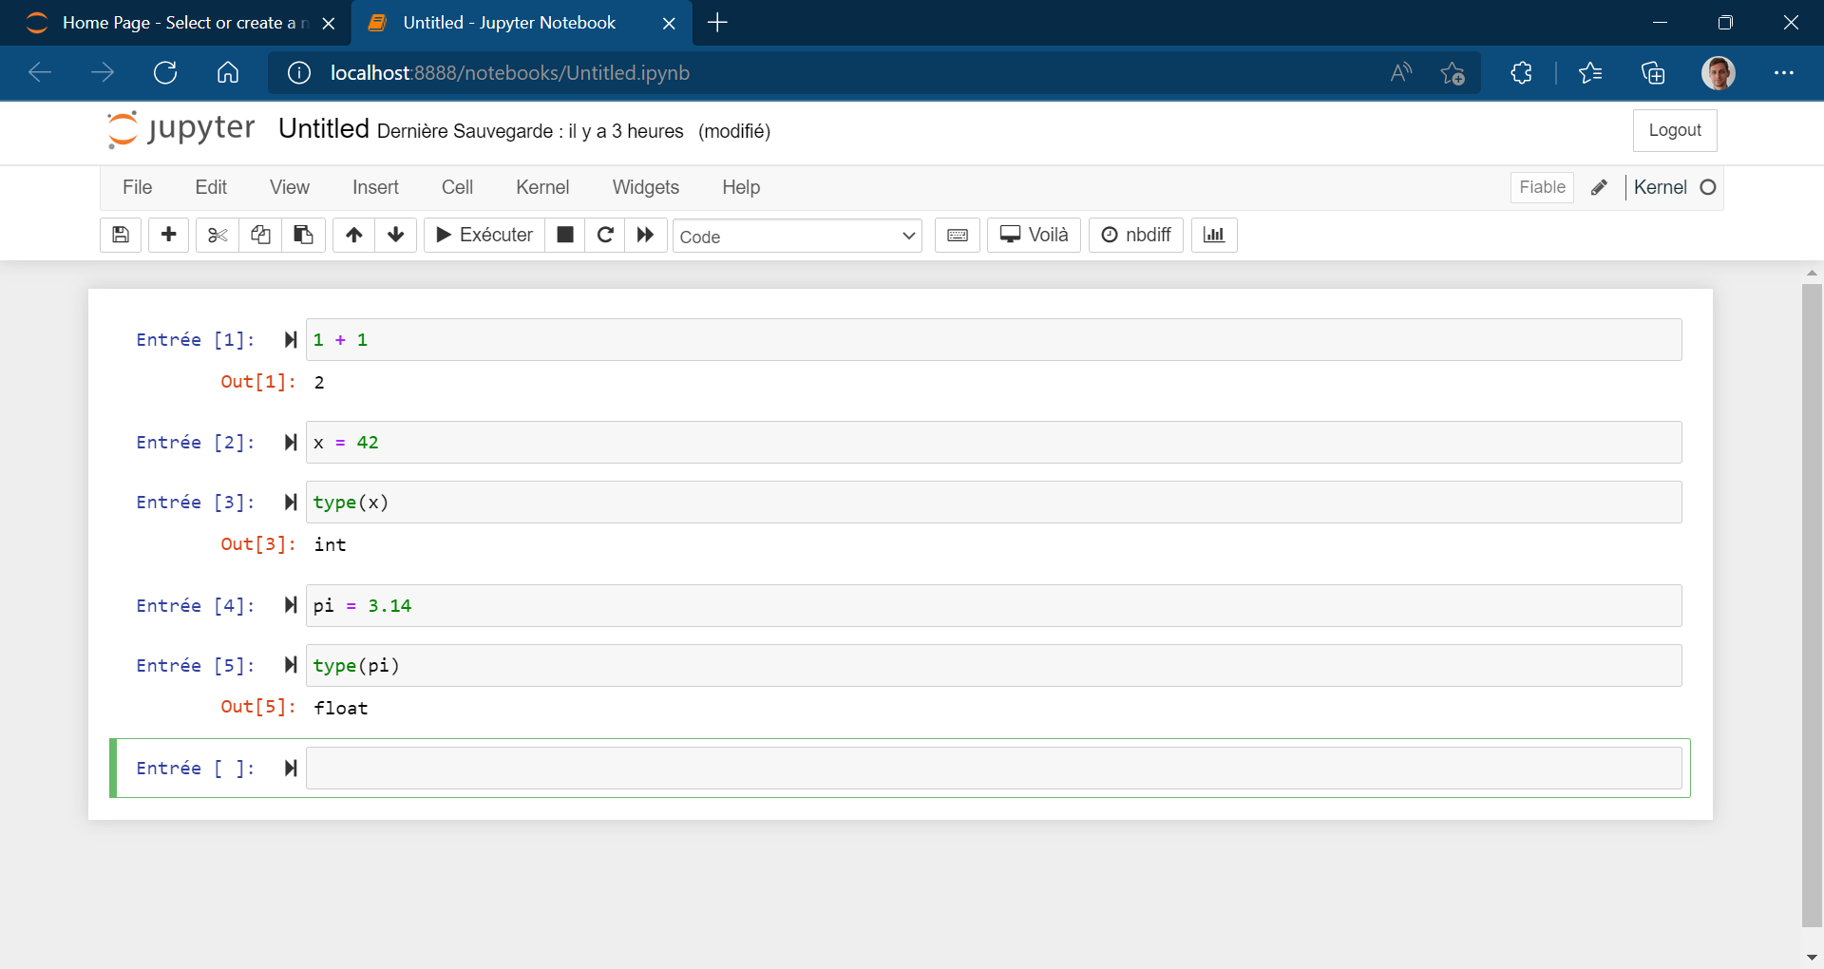
Notes:
How notebooks are shared >> teaching, github

Slide 38
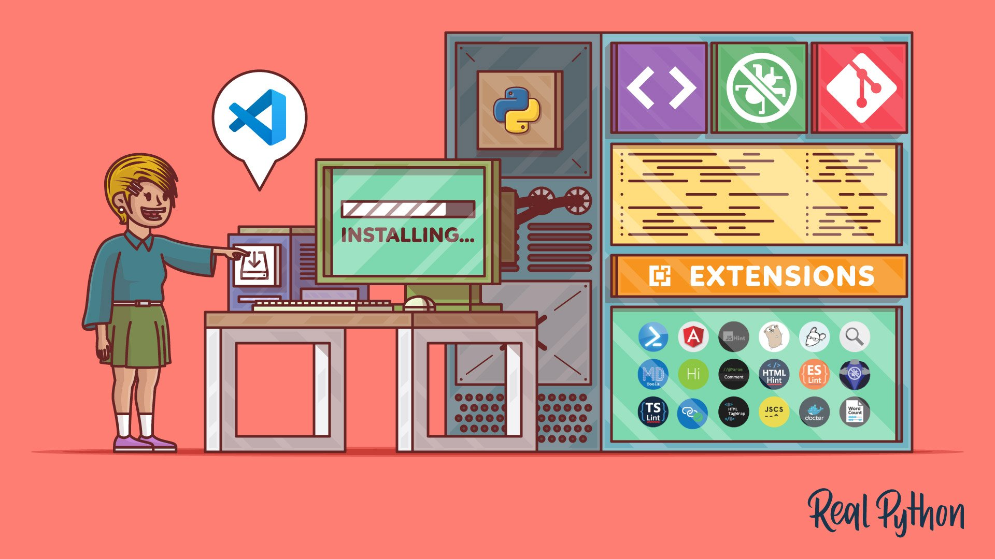
https://realpython.com/python-development-visual-studio-code/

Slide 39
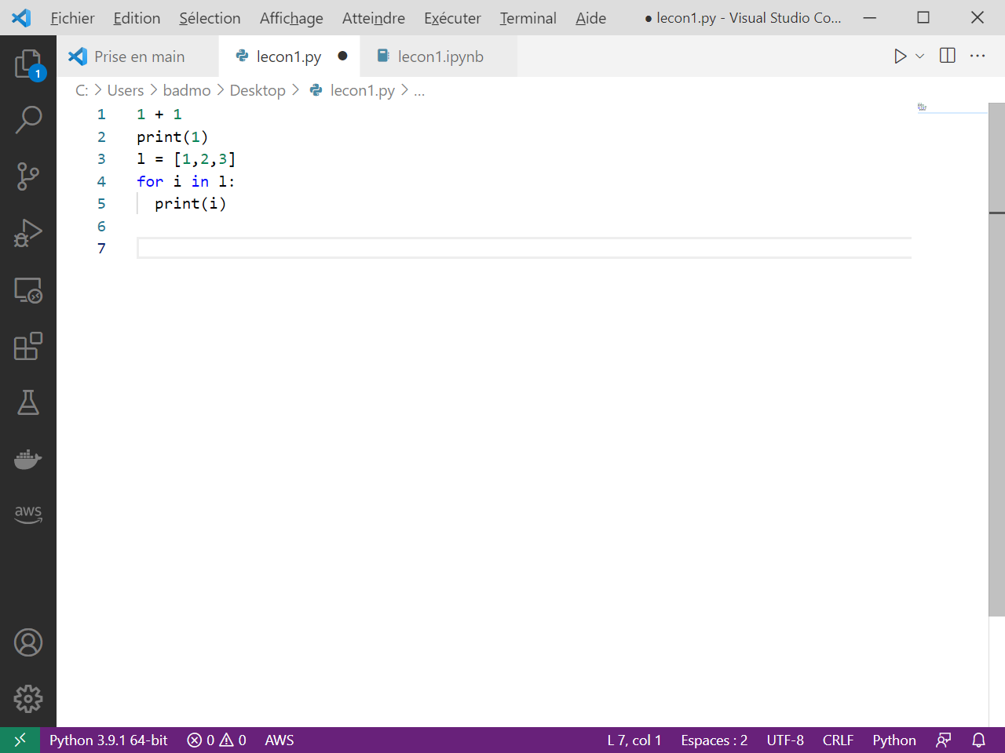
Visual Studio Code Recommended editor for Python
https://code.visualstudio.com/

Slide 40
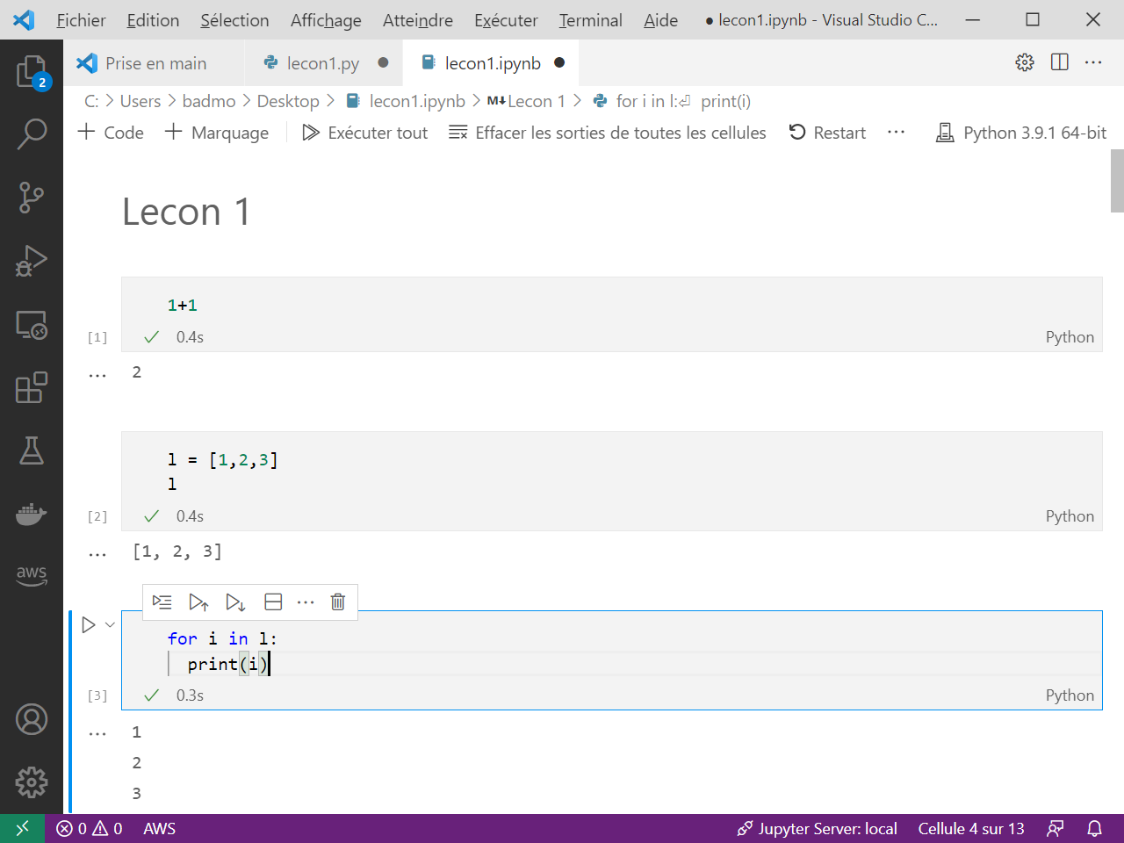
Notebook format for interactivity

Slide 41
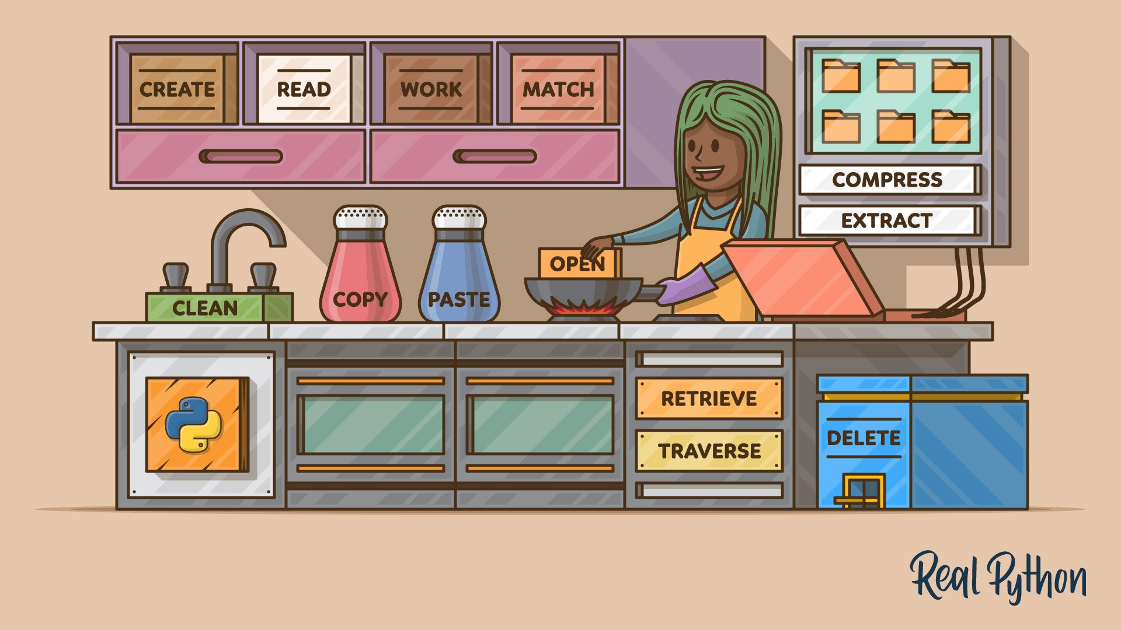
https://realpython.com/working-with-files-in-python/
Notes:
https://realpython.com/working-with-files-in-python/
https://realpython.com/read-write-files-python/

Slide 42
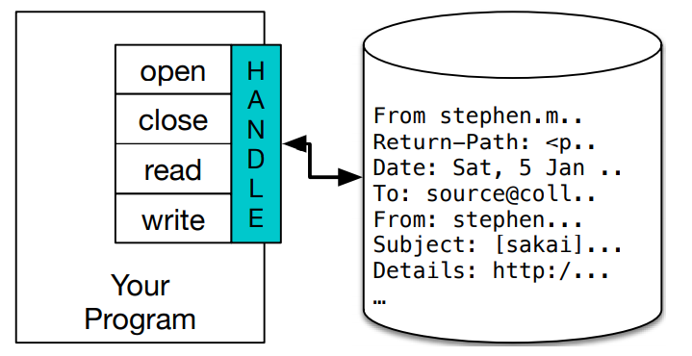
3. Import/export data from files
>>> fhand = open('mbox.txt’)
>>> print(fhand)
<_io.TextIOWrapper name='mbox.txt' mode='r' encoding='cp1252'>
Python for Everybody – Chap 7 Files

Slide 43
Reading files
fhand = open('mbox-short.txt’)
count = 0
for line in fhand:
count = count + 1
print('Line Count:', count)
https://www.py4e.com/code3/mbox.txt

Slide 44
Writing files
>>> fout = open('output.txt', 'w’)
>>> line1 = "This here's the wattle,\n“
>>> fout.write(line1)
>>> line2 = 'the emblem of our land.\n’
>>> fout.write(line2)
>>> fout.close()

Slide 45
More on Files
7.1: Persistence
7.2: Opening Files
7.3: Text files and Lines
7.4: Reading Files
7.5: Searching through a File
7.6: Letting the user choose the file name
7.7: Using try, except, and open
7.8: Writing Files
7.9: Debugging
7.E: Files (Exercises)
7.G: Files (Glossary)
Python for Everybody – Chap 7 Files

Slide 46

https://realpython.com/python-virtual-environments-a-primer/
Notes:
https://realpython.com/python-virtual-environments-a-primer/

Slide 47
Virtual Environments venv
$ python -m venv env
$ .\env\Scripts\activate
$ (env) pip install –r requirements.txt
Notes:
If you have different projects leveraging different versions of the same
package, or if you want a way to replicate your production environment
in a clean space, use [Python virtual environment](https://docs.python.org/3/tutorial/venv.html).
It’s a type of virtualization at the language level (like Virtual Machine at the
Machine level, or Docker container at the Operating System level). This
is the default way (shipped with base Python) to create a virtual
environment called `env`

Slide 48
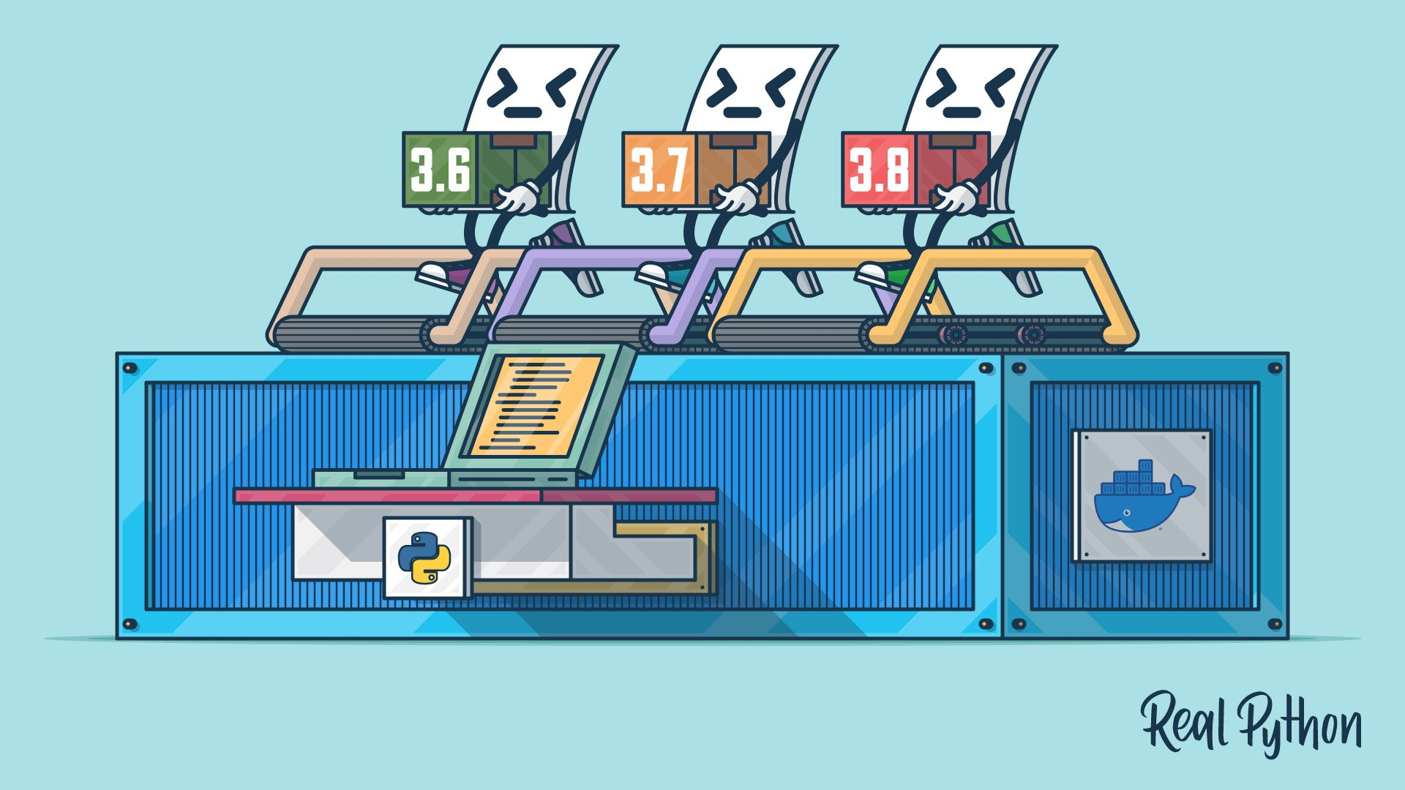
https://realpython.com/python-versions-docker/
Notes:
https://realpython.com/offline-python-deployments-with-docker/

Slide 49
Docker
Dockerfile
FROM python:3.7.5-slim
WORKDIR /usr/src/app
RUN python -m pip install \
numpy \
pandas
COPY test.py .
CMD ["python", "test.py"]
$ docker build –t test .
[+] Building 71.3s (9/9) FINISHED
$ docker run --rm test
1
2
3

Slide 50

https://realpython.com/python-testing/

Slide 51
Unit testing
test_sum.py
def test_sum():
assert sum([1, 2, 3]) == 6, "Should be 6"
if __name__ == "__main__":
test_sum()
print("Everything passed")
$ python test_sum.py
Everything passed

Slide 52


More on Object-Oriented Programming
https://realpython.com/python3-object-oriented-programming/
https://realpython.com/python-super/

Slide 53
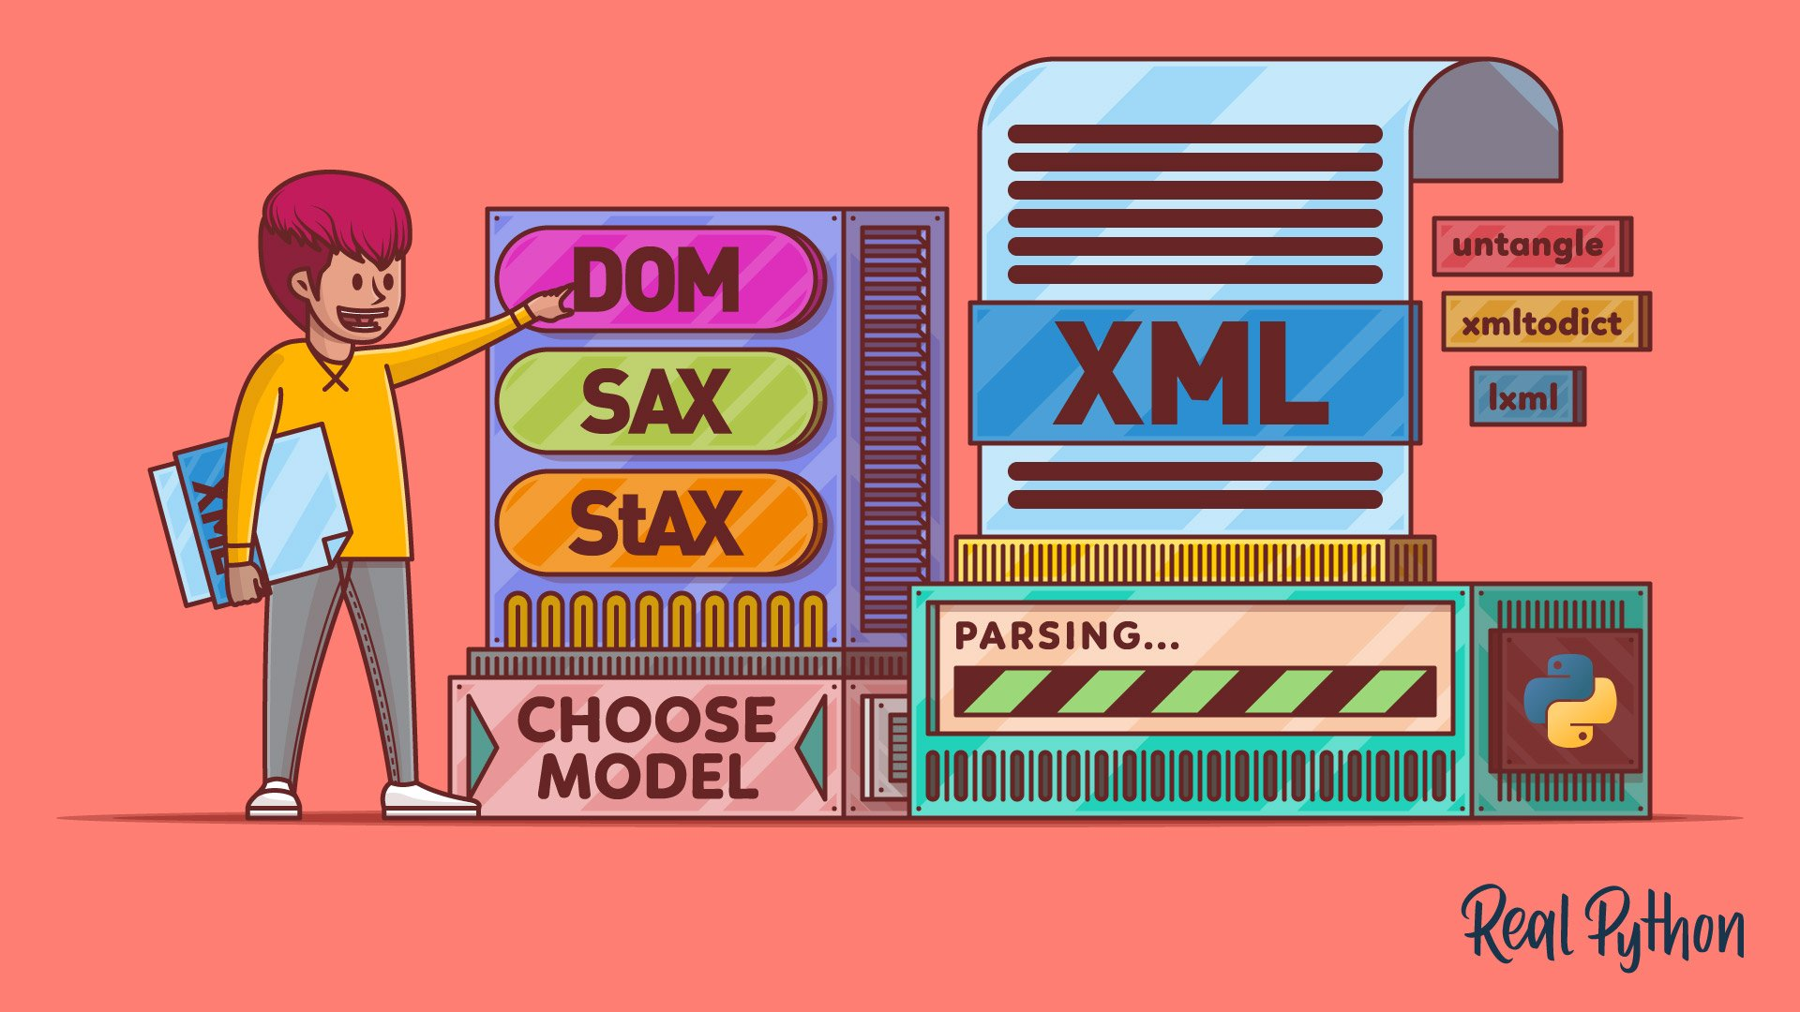

More on text processing
https://realpython.com/python-xml-parser/
https://realpython.com/beautiful-soup-web-scraper-python/
Notes:
https://realpython.com/python-web-scraping-practical-introduction/

Slide 54
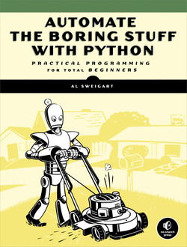
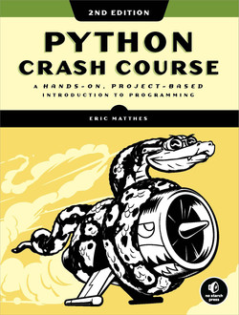
More resources Books
https://automatetheboringstuff.com/
Notes:
https://github.com/realpython/materials

Slide 55
Exercises

Slide 56
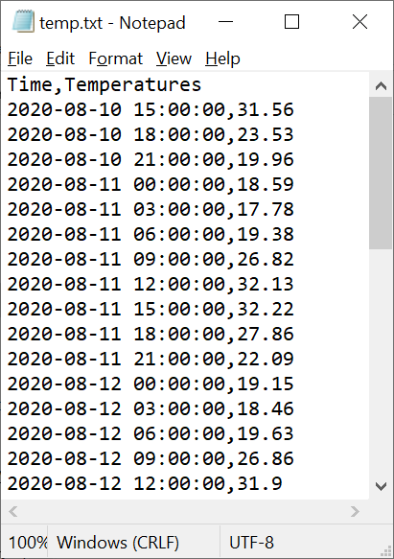
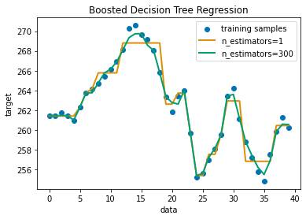
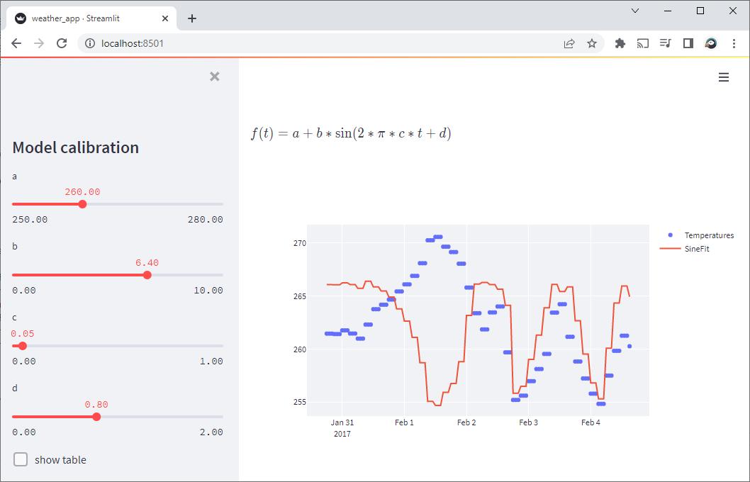
Weather.py build a scientific app with Python
Access Data (read file, request web service)
Develop Algo
Deploy App
Decision Tree Regression with AdaBoost — scikit-learn
Streamlit — Python-based data apps
Notes:
insidelabs-git.mathworks.com/ydebray/python-exercises

Slide 57
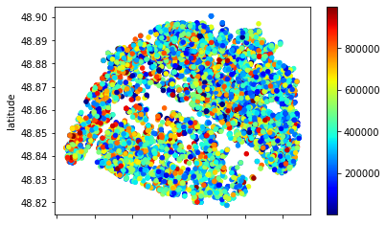
Immo.py
Call a function price, that will return the price of real estate in Paris as a dictionary
Get a list of location (lat,lon) and price
Select only the estate under 500k€
Write a file containing this data
(Bonus: plot the data on a map)

Slide 58
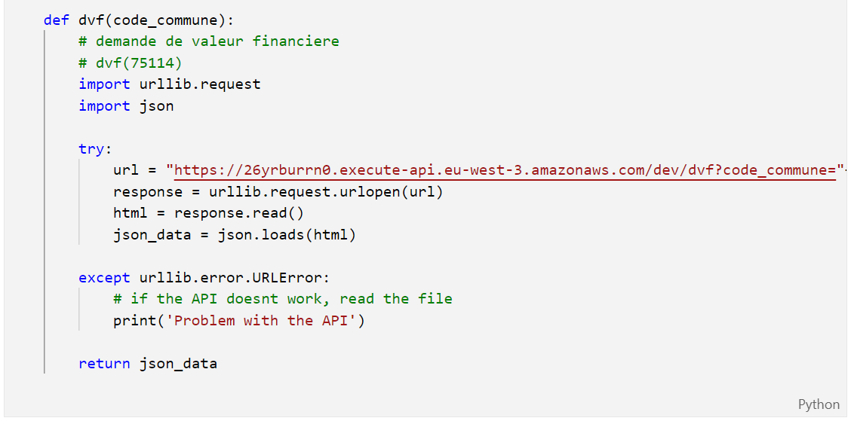
Immo.py
https://gist.github.com/slevin48/05c0d4f348f0f10870a0fa721cfcb1b1

Slide 59
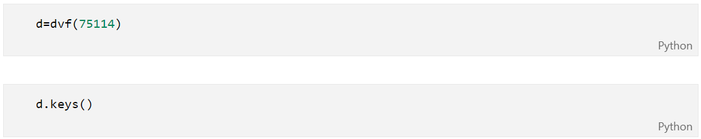
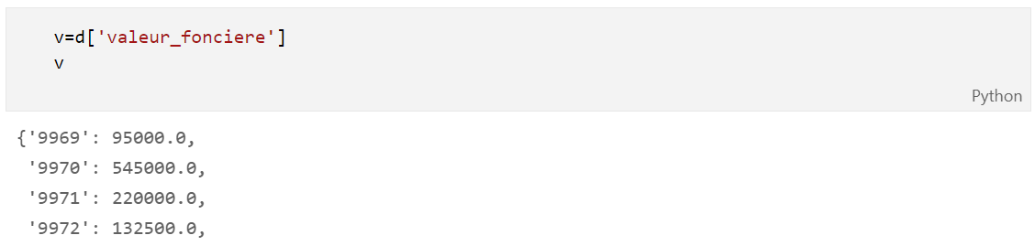
Immo.py

Slide 60
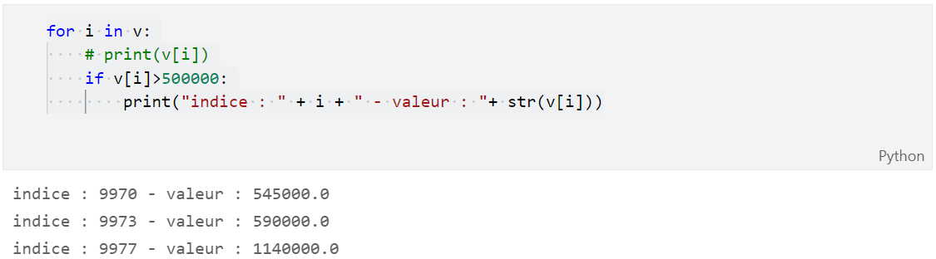
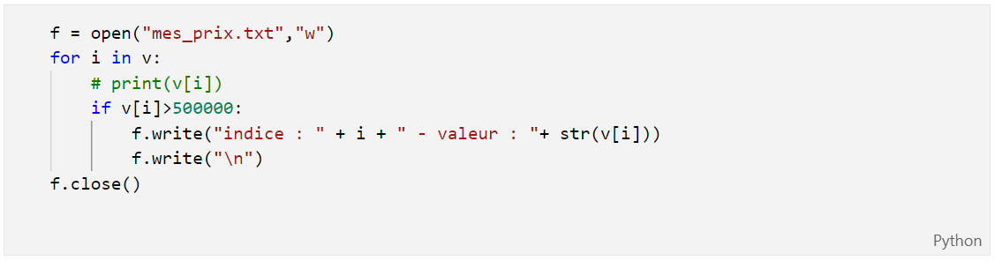
Immo.py

Slide 61

Music.py
Parse Streaming History
Create a dictionary
id
artist name
track name
Music Taste Analysis
Get music features
Plot features
Get recommendation

Slide 62
Music for loop
with open("saved_tracks_20210306.json","r") as f:
results = json.load(f)
tracks = []
for idx, item in enumerate(results['items']):
track = item['track']
tracks.append([idx, track['artists'][0]['name'], track['name']])

Slide 63
Music Dict
trackDict = {"id":[], "artist":[],"name":[]}
for idx, item in enumerate(results['items']):
track = item['track']
trackDict["id"].append(idx)
trackDict["artist"].append(track['artists'][0]['name'])
trackDict["name"].append(track['name'])

Slide 64
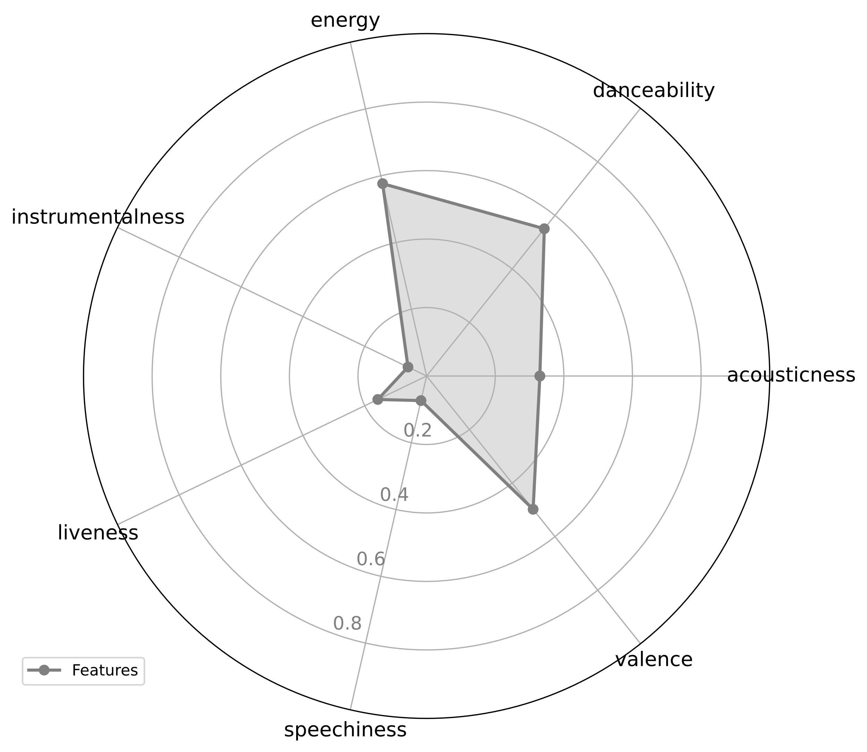
Music taste analysis

Slide 65
Music taste analysis
import spotifyAPI
from secret import clientId,clientSecret token = spotifyAPI.get_token(clientId,clientSecret)
lucy_id = spotifyAPI.get_track_id2('Lucy in the Sky', token, artist = 'The Beatles’)
url = "https://open.spotify.com/track/"+lucy_id
import webbrowser
webbrowser.open(url)

Slide 66
import pandas as pd
lucy_features = spotifyAPI.get_features(lucy_id,token)
df = pd.DataFrame(lucy_features, index=[0])
df_features = df.loc[: ,['acousticness', 'danceability', 'energy', 'instrumentalness', 'liveness', 'speechiness', 'valence’]]
spotifyAPI.feature_plot(df_features)

Slide 67
Music recommendation
json_response = spotifyAPI.get_track_reco(lucy_id,token)
uris =[]
for i in json_response['tracks']:
uris.append(i)
print(f"\"{i['name']}\" by {i['artists'][0]['name']}")

Slide 68

Sources
Data Structures
Using Python to Access Web Data
Using Databases with Python
Capstone: Retrieving, Processing, and Visualizing Data with Python
PY4E - Python for Everybody
Python for Everybody (dr-chuck.com)

Slide 69

Go further
Crash Course on Python | Google
Using Python to Interact with the Operating System
Google IT Automation with Python
Configuration Management and the Cloud
Troubleshooting and Debugging Techniques
Introduction to Git and GitHub | Google
Automating Real-World Tasks with Python | Google

Slide 70
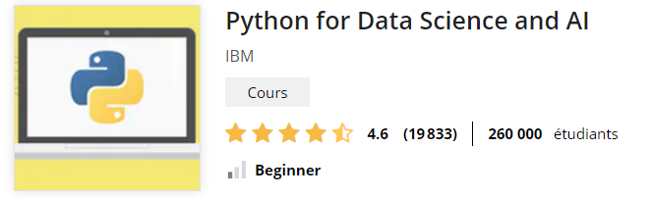
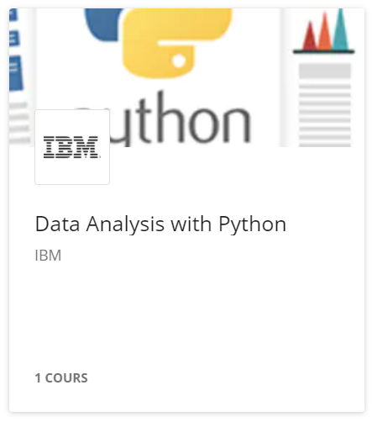
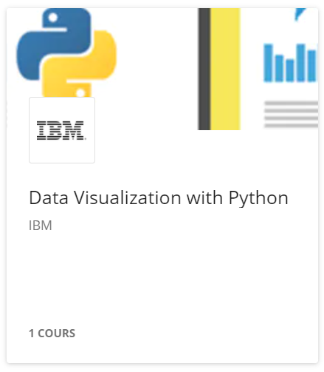
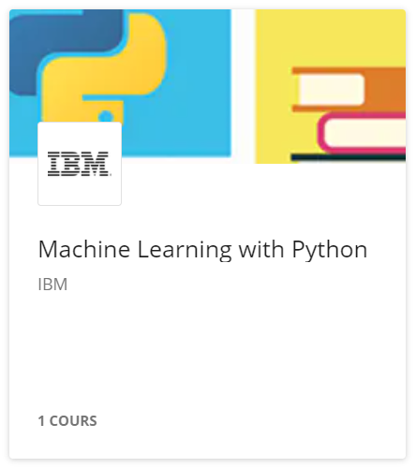
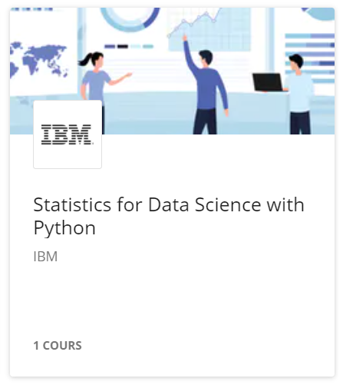
Data Science

Slide 71
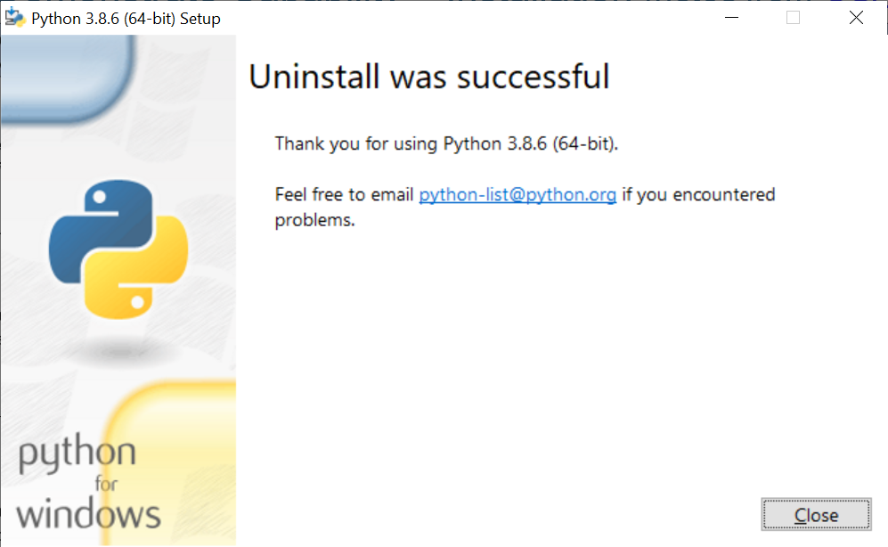
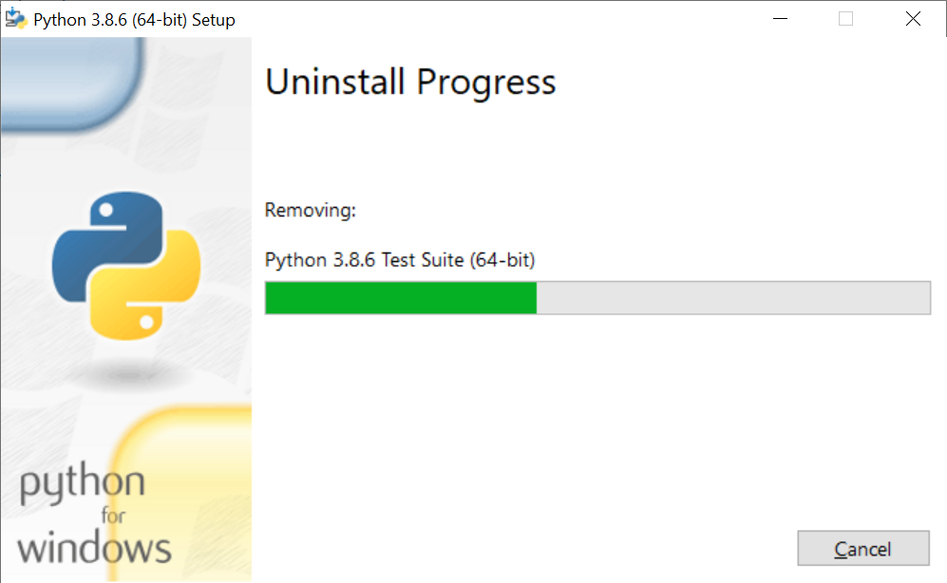
Uninstall Python

